Slide 1
IS3313 Systems Software
Lecture 12th October 2018

Slide 2
Overview
CISC
RISC
Pipelining
Compilers

Slide 3
What is CISC?
CISC is an acronym for Complex Instruction Set Computer and are chips that are easy to program and which make efficient use of memory. Since the earliest machines were programmed in assembly language and memory was slow and expensive, the CISC philosophy made sense, and was commonly implemented in such large computers as the PDP-11 and the DECsystem 10 and 20 machines.
Most common microprocessor designs such as the Intel x86 and Motorola 68K series followed the CISC philosophy.
But recent changes in software and hardware technology have forced a re-examination of CISC and many modern CISC processors are hybrids, implementing many RISC principles.
CISC was developed to make compiler development simpler. It shifts most of the burden of generating machine instructions to the processor. For example, instead of having to make a compiler write long machine instructions to calculate a square-root, a CISC processor would have a built-in ability to do this.

Slide 4
What is an instruction set?
Machine Language is very specific to a certain type of CPU. Each CPU will have a certain repertoire of instructions that it can decode and execute. This is called the instruction set of the CPU or the Instruction Set Architecture (ISA). Information which must be present in an instruction
Operation e.g. ADD, SUBTRACT etc. Where to get the data Memory addresses, or the data may be in the Registers/datapath already, or no data may be needed. e.g. HALT instruction.
Where to put the result A memory address or perhaps temporarily within a register/ datapath.
Where to find the next instruction An address or, to allow decisions to be made, a condition and a choice of addresses.

Slide 5
Instruction Format
Opcode The operation itself is usually represented by a code called the opcode (for OPeration CODE) Operands All the other parts of an instruction are called operands.
Addresses Some of the operands may be the actual addresses of data in memory.
Example
ADD AX,[102]
The opcode is ADD
There are two operands, AX and [102]
AX is a register that contains the data
This instruction contains one address - 102

Slide 6
CISC Attributes
The design constraints that led to the development of CISC (small amounts of slow memory and the fact that most early machines were programmed in assembly language) give CISC instructions sets some common characteristics:
A 2-operand format, where instructions have a source and a destination.
Register to register, register to memory, and memory to register commands.
Multiple addressing modes for memory, including specialized modes for indexing through arrays
Variable length instructions where the length often varies according to the addressing mode
Instructions which require multiple clock cycles to execute.
E.g. Pentiums, Cores AMDs are considered CISC processors

Slide 7
CISC hardware architectures
Most CISC hardware architectures have several characteristics in common
Complex instruction-decoding logic, driven by the need for a single instruction to support multiple addressing modes.
A small number of general purpose registers. This is the direct result of having instructions which can operate directly on memory and the limited amount of chip space not dedicated to instruction decoding, execution, and microcode storage.
Several special purpose registers. Set aside special registers for the stack pointer, interrupt handling, and so on. This can simplify the hardware design somewhat, at the expense of making the instruction set more complex.
A Condition code register which is set as a side-effect of most instructions. This register reflects whether the result of the last operation is less than, equal to, or greater than zero and records if certain error conditions occur.

Slide 8
Optimising CISC Machines
At the time of their initial development, CISC machines used available technologies to optimize computer performance.
Microprogramning is as easy as assembly language to implement, and much less expensive than hardwiring a control unit.
The ease of micro-coding new instructions allowed designers to make CISC machines upwardly compatible: a new computer could run the same programs as earlier computers because the new computer would contain a superset of the instructions of the earlier computers.
As each instruction became more capable, fewer instructions could be used to implement a given task. This made more efficient use of the relatively slow main memory.
Because microprogram instruction sets can be written to match the constructs of high-level languages, the compiler does not have to be as complicated.

Slide 9
CISC Disadvantages
Designers soon realised that the CISC philosophy had its own problems, including:
Earlier generations of a processor family generally were contained as a subset in every new version - so instruction set & chip hardware become more complex with each generation of computers.
So that as many instructions as possible could be stored in memory with the least possible wasted space, individual instructions could be of almost any length - this means that different instructions will take different amounts of clock time to execute, slowing down the overall performance of the machine.
Many specialized instructions aren't used frequently enough to justify their existence -approximately 20% of the available instructions are used in a typical program.
CISC instructions typically set the condition codes as a side effect of the instruction. Not only does setting the condition codes take time, but programmers have to remember to examine the condition code bits before a subsequent instruction changes them.

Slide 10
What is RISC?
RISC, or Reduced Instruction Set Computer. is a type of microprocessor architecture that utilizes a small, highly-optimized set of instructions, rather than a more specialized set of instructions often found in other types of architectures.
History The first RISC projects came from IBM, Stanford, and UC-Berkeley in the late 70s and early 80s. The IBM 801, Stanford MIPS, and Berkeley RISC 1 and 2 were all designed with a similar philosophy which has become known as RISC. Certain design features have been characteristic of most RISC processors:
one cycle execution time: RISC processors have a CPI (clock per instruction) of one cycle. This is due to the optimization of each instruction on the CPU and a technique called PIPELINING
pipelining: a technique that allows for simultaneous execution of parts, or stages, of instructions to more efficiently process instructions;
large number of registers: the RISC design philosophy generally incorporates a larger number of registers to prevent in large amounts of interactions with memory

Slide 11
Before the RISC era
Compilers were hard to build especially for machines with registers
Make machine do more work than software
Have instructions load and store directly to memory (memory-to-memory operations)
Software costs were rising and hardware costs were dropping
Move as much functionality to hardware
Magnetic core memory was used as main memory which was slow and expensive
Minimize assembly code
Complex Instruction Set Computers (CISC)
Use complex instructions that are combinations of MULT, ADD…etc.
Notes:
Before the RISC era, technology limitations supported the use of a richer instruction set
Compilers were hard to build especially for machines with registers
so engineers tried to have the machine do as much work as possible
and have instructions load and store directly to and from memory
Software costs were also rising as hardware costs were decreasing
this also supported moving functionality to the hardware
At the time, magnetic core memory was used as main memory
this was slow and expensive so engineers tried to minimize the lines of assembly
Use of richer instruction set architecture are now called CISC – complex instruction set computers
they use complex instructions such as MULT or ADD that perform the load, computation, and store all in one instruction

Slide 12
Technology was advancing
Compilers were improving
Simple compilers found it difficult to use more complex instructions
Optimizing compilers rarely needed more powerful instructions
Caches
allowed main memory to be accessed at similar speeds to control memory
Semiconductor memory was replacing magnetic core memory
Reduced performance gap between control and main memory
Notes:
As design principles were solidifying, technology was advancing around them
Simple compilers found it difficult to use more complex instructions and optimizing compilers rarely needed more the more powerful instructions.
The invention of caches along with the replacement of magnetic core memory with semiconductor memory
reduced the performance gap between control and main memory

Slide 13
Inception of RISC
1974 – (IBM) proved that 80% of work was done using only 20% of the instructions
Three RISC projects
IBM 801 machine (1974)
Berkeley’s RISC-I and RISC-II processors (1980)
Stanford’s MIPS processor (1981)
1986 – announcement of first commercial RISC chip
Notes:
in 1974, John Cocke with IBM proved that about 80% of work was done using 20% of instructions
This sparked three RISC based research projects
IBM 801 machine in 1974
Berkeley’s RISC-I and RISC-II processors in 1980
And Stanford’s MIPS processor in 1981
Each of these projects took different paths in their research they all complemented and reinforced each others findings convincing many supporters
In 1986 the computer industry began announcing commercial RISC chips

Slide 14
RISC Approach
Use only simple instructions that can be executed within one clock cycle
Fewer transistors for instructions = more registers
Pipelining
Register-to-register operations
Operand reuse
Reduction of load/store

Slide 15
CISC/RISC Attributes
The main characteristics of CISC microprocessors are:
Extensive instructions.
Complex and efficient machine instructions.
Micro-encoding of the machine instructions.
Extensive addressing capabilities for memory operations.
Relatively few registers.
In comparison, RISC processors are more or less the opposite of the above:
Reduced instruction set.
Less complex, simple instructions.
Hardwired control unit and machine instructions.
Few addressing schemes for memory operands with only two basic instructions, LOAD and STORE
Many symmetric registers which are organised into a register file.

Slide 16
Pipelining
Pipelining: “A means of introducing parallelism into the essentially sequential nature of a machine-instruction program”

Slide 17
Pipelining
Sequential
IF
ID
OF
OE
OS
IF
ID
OF
OE
OS
Clock Cycle
IF
ID
OF
OE
OS
Pipelined
IF
ID
OF
OE
OS
IF – Instruction Fetch
ID – Instruction Decode
OF – Operand Fetch
OE – Operand Execution
OS – Operation Store
IF
ID
OF
OE
OS
Clock Cycle
IF
ID
OF
OE
OS
Time

Slide 18
Pipelining
Data Dependency
IF – Instruction Fetch
ID – Instruction Decode
OF – Operand Fetch
OE – Operand Execution
OS – Operation Store
IF
ID
OF
OE
OS
IF
ID
OF
OE
OS
IF
ID
OF
OE
OS
IF
ID
OF
OE
OS
IF
ID
OF
OE
OS
Branch Address Dependency
IF
ID
OF
OE
OS
IF
ID
OF
OE
OS

Slide 19
Pipelining
Data dependencies can be addressed by reordering the instructions when possible (compiler)
Performance degradation from branches can be reduced by branch prediction or executing instructions for both branches until the correct branch is identified

Slide 20
Other Advantages
New microprocessors can be developed and tested more quickly if being less complicated is one of it’s aims
Smaller instruction sets are easier for compiler programmers to use

Slide 21
Pipelining
RISC Pipelines
A RISC processor pipeline operates in much the same way, although the stages in the pipeline are different. While different processors have different numbers of steps, they are basically variations of these five, used in the MIPS R3000 processor:
- fetch instructions from memory
- read registers and decode the instruction
- execute the instruction or calculate an address
- access an operand in data memory
- write the result into a register

Slide 22
RISC Pipelining
Most instructions are register to register
Most instructions: have two phases of execution
I: Instruction fetch
E: Execute
ALU operation with register input and output
For load and store instuctions
I: Instruction fetch
E: Execute
Calculate memory address
D: Memory
Register to memory or memory to register operation

Slide 23
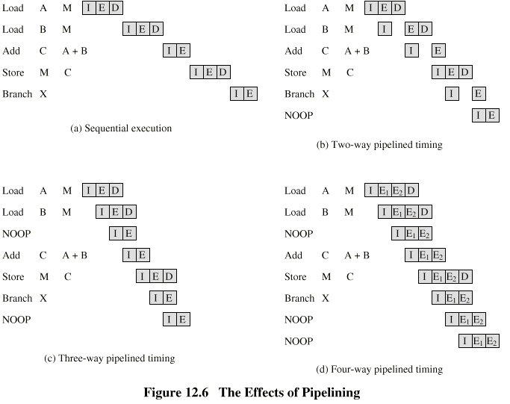
Effects of Pipelining
NOOP: instruction consists of an operation code and no operands, a blank in effect to keep the pipeline full
Notes:
Page 501 of handout.

Slide 24
Optimization of Pipelining
Delayed branch
Does not take effect until after execution of following instruction
This following instruction is the delay slot

Slide 25
RISC Disadvantages
There is still considerable controversy among experts about the ultimate value of RISC architectures. Its proponents argue that RISC machines are both cheaper and faster, and are therefore the machines of the future.
However, by making the hardware simpler, RISC architectures put a greater burden on the software. Is this worth the trouble because conventional microprocessors are becoming increasingly fast and cheap anyway?

Slide 26
RISC vs. CISC: A Simple Code Example
Multiplying two numbers
A = A x B (multiply the contents of A and B and place in A
The CISC Approach
The primary goal of CISC architecture is to complete a task in as few lines of assembly as possible. This is achieved by building processor hardware that is capable of understanding and executing a series of operations, this is where our CISC architecture introduced .
CISC processor MULT instruction
When executed, this instruction
1. Loads the two values (A, B) into separate registers (CX, DX)
2. Multiplies the operands in the execution unit
3. Stores the product in the appropriate register.
Thus, the entire task of multiplying two numbers can be completed with one instruction:
CISC instruction: MULT A,B

Slide 27
CISC MULT Instruction
MULT is a “complex instruction.”
It operates directly on the computer’s RAM memory
Does not require the programmer to explicitly programme any load or store instructions
Advantage-
Compiler has to do very little work to translate a high-level language statement into assembly
Length of the code is relatively short
Very little RAM is required to store instructions
The emphasis is put on building complex instructions directly into the hardware

Slide 28
The RISC Approach
RISC processors only use simple instructions that can be executed in one clock cycle.
The “MULT” command described above could be divided into three separate commands:
LOAD which moves data from RAM to a register
PROD multiplies the two operands in the registers
STORE moves data from a register to RAM

Slide 29
RISC Example
In order to perform the exact series of steps described in the CISC approach, a programmer would need to code four lines of assembly:
LOAD R1, A
LOAD R2,B
PROD A, B
STORE R3, A
They require no decoding
Minimum control
They can be fed into pipelines IF there are no data dependencies
Can be executed in parallel pipelines

Slide 30
RISC Execution
At first, this may seem like a much less efficient way of completing the operation.
Because there are more lines of code, more RAM is needed to store the assembly level instructions.
The compiler must also perform more work to convert a high-level language statement into code of this form.
Each instruction requires only one clock cycle to execute, the entire program will execute in approximately the same amount of time as the multi-cycle “MULT” command.
These RISC “reduced instructions” require less transistors of hardware space than the complex instructions, leaving more room for general purpose registers. Because all of the instructions execute in a uniform amount of time (i.e. one clock)
Pipelining is possible.

Slide 31
RISC Efficiency
LOAD/STORE mechanism
Separating the LOAD and STORE instructions actually reduces the amount of work that the computer must perform.
After a CISC-style MULT command is executed, the processor automatically erases the registers.
If one of the operands needs to be used for another computation, the processor must re-load the data from the RAM into register.
In RISC processors, the operand will remain in the register until another value is loaded in its place.

Slide 32
CISC versus RISC
CISC | RISC
Emphasis on hardware | Emphasis on software
Includes multi-clock complex instructions | Single-clock, reduced instruction only
Memory-to-memory: "LOAD" and "STORE" incorporated in instructions | Register to register: "LOAD" and "STORE" are independent instructions
Small code sizes, high cycles per second | Low cycles per second, large code sizes
Transistors used for storing complex instructions | Spends more transistors on memory registers
https://cs.stanford.edu/people/eroberts/courses/soco/projects/risc/risccisc/

Slide 33
Modern Day Advances
CISC and RISC Convergence
State of the art processor technology has changed significantly since RISC chips were first introduced in the early '80s.
Because a number of advancements are used by both RISC and CISC processors, the lines between the two architectures have begun to blur.
The two architectures almost seem to have adopted the strategies of the other.
Because processor speeds have increased, CISC chips are now able to execute more than one instruction within a single clock. This also allows CISC chips to make use of pipelining. With other technological improvements, it is now possible to fit many more transistors on a single chip.

Slide 34
Summay
As memory speed increased, and high-level languages displaced assembly language, the major reasons for CISC began to disappear, and computer designers began to look at ways computer performance could be optimized beyond just making faster hardware.
One of their key realizations was that a sequence of simple instructions produces the same results as a sequence of complex instructions, but can be implemented with a simpler (and faster) hardware design. (Assuming that memory can keep up.) RISC (Reduced Instruction Set Computers) processors were the result.
CISC and RISC implementations are becoming more and more alike. Many of today’s RISC chips support as many instructions as yesterday's CISC chips. And today's CISC chips use many techniques formerly associated with RISC chips.

Slide 35
Summary CISC vs. RISC
CISC | RISC
Emphasis on hardware | Emphasis on software
Includes multi-clock complex instructions | Single-clock, reduced instruction only
Memory-to-memory: "LOAD" and "STORE" incorporated in instructions | Register to register: "LOAD" and "STORE" are independent instructions
Small code sizes, high cycles per second | Low cycles per second, large code sizes
Large instruction set | Compact instruction set
Complex, powerful instructions | Simple hard-wired machine code and control unit
Instruction sub-commands micro-coded in on board ROM | Pipelining of instructions
Compact and versatile register set | Numerous registers
Numerous memory addressing options for operands | Compiler and IC developed simultaneously

Slide 36
Compilers

Slide 37



What’s a compiler?
All computers only understand machine language
Therefore, high-level language instructions must be translated into machine language prior to execution
This is
a program
10000010010110100100101……

Slide 38
What is a compiler?
Compiler System software that translates high-level languages into machine language
program.c
while (c!='x')
{
if (c == 'a' || c == 'e' || c == 'i')
printf("Congrats!");
else
if (c!='x')
printf(“Bad Luck");
}
Congrats!
prog
Compiler
10000010010110100100101……
gcc -o prog program.c

Slide 39
Assembler (a kind of compiler)
LOAD X Assembly
(opcode table)
(symbol table)
0101 0000 0000 1001 Machine Language
One-to-one translation

Slide 40
Compiler (high-level language translator)
a = b + c - d;
0101 00001110001 LOAD B
0111 00001110010 ADD C
0110 00001110011 SUBTRACT D
0100 00001110100 STORE A
0101 00001110001 0111 00001110010…….
One-to-many translation

Slide 41
Goals of a compiler
Code produced must be correct
A = (B+C)-(D+E);
Possible translation:
LOAD B
ADD C
STORE B
LOAD D
ADD E
STORE D
LOAD B
SUBTRACT D
STORE A
Is this correct?
No! STORE B and STORE D changes the values of variables B and D which is the high-level language does not intend

Slide 42
Goals of a compiler
Code produced should be reasonably efficient and concise
Compute the sum - 2x₁₊ 2x₂₊ 2x₃₊ 2x_{4+….} 2x₅₀₀₀₀
sum = 0.0
for(i=0;i<50000;i++) {
sum = sum + (2.0 * x[i]);
Optimizing compiler:
sum = 0.0
for(i=0;i<50000;i++) {
sum = sum + x[i];
sum = sum * 2.0; 49,999 less instructions

Slide 43
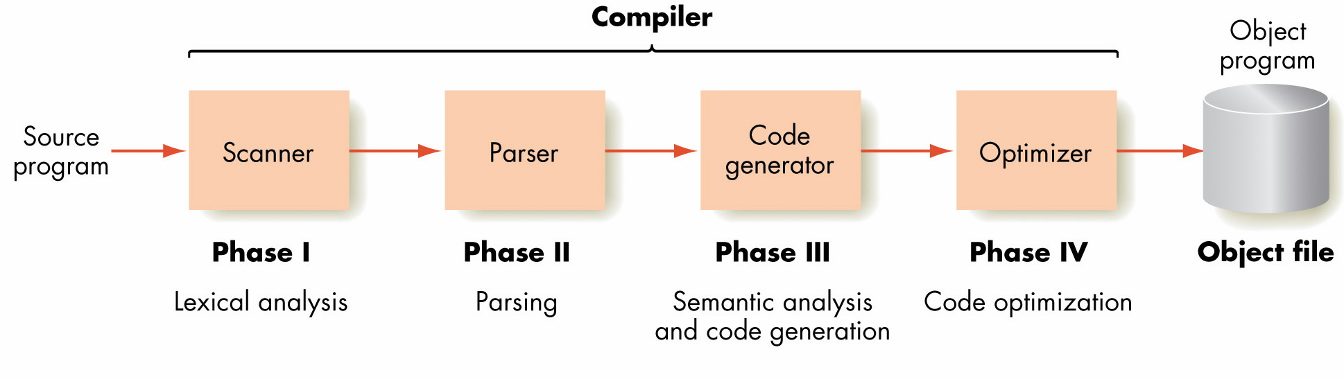
Compilation

Slide 44
The Compilation Process
Phase I: Lexical analysis
Compiler examines the individual characters in the source program and groups them into syntactical units called tokens
Phase II: Parsing
The sequence of tokens formed by the scanner is checked to see whether it is syntactically correct
Source
code
Scanner
Groups
of
tokens
Groups
of
tokens
Parser
correct
not correct

Slide 45
The Compilation Process
Phase III: Semantic analysis and code generation
The compiler analyzes the meaning of the high-level language statement and generates the machine language instructions to carry out these actions
Groups
of
tokens
Code
Generator
Machine
language

Slide 46
The Compilation Process
Phase IV: Code optimization
The compiler takes the generated code and sees whether it can be made more efficient
Machine
language
Code
Optimizer
Machine
language

Slide 47
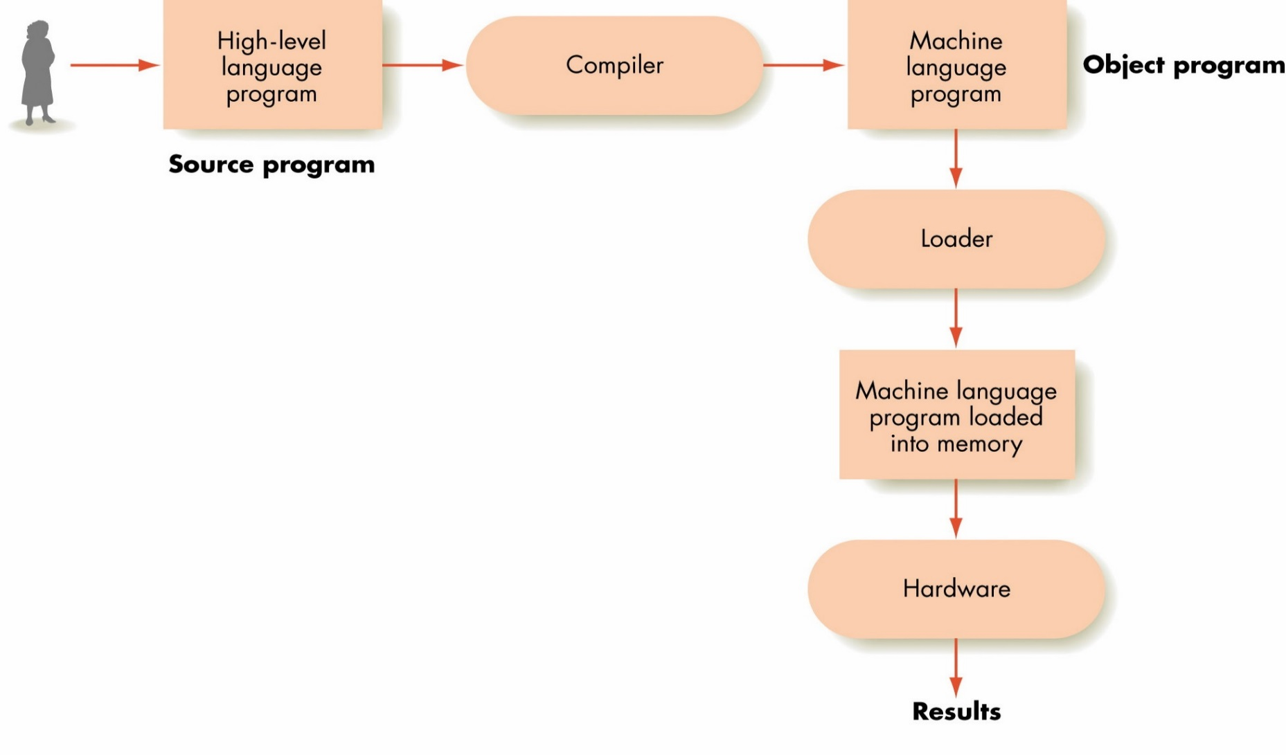
Overall Execution Sequence on a High-Level Language Program

Slide 48
The Compilation Process
Source program
Original high-level language program
Object program
Machine language translation of the source program

Slide 49
Compilation, Assembly, and Static Linking
Facilitates debugging of the compiler
Source
Program
Compiler
Assembly Program
extern printf();
Assembler
_printf _fget _fscan …
Static Library Object Code
Linker
Binary
Executable

Slide 50
Compilation, Assembly, and Dynamic Linking
Dynamic libraries (DLL, .so, .dylib) are linked at run-time by the OS (via stubs in the executable)
Source
Program
Compiler
Assembly Program
extern printf();
Assembler
Shared Dynamic Libraries
Incomplete Executable
_printf, _fget, _fscan, …
Output
Input

